Slide 1
Course Name: Machine Learning
Faculty Name: Sangeeta Barua
Department : Robotics and Automation Engineering

Slide 2
Concepts Covered:
An Introduction
Descriptors/ Feature Vectors
Machine Learning vs. Deep Learning
Discriminative/ Generative Model
Challenges
Power of Deep Learning

Slide 3
What is learning?

Slide 4
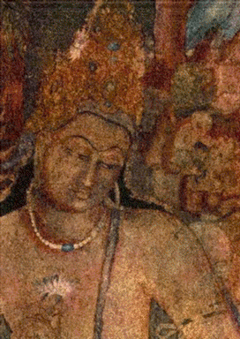
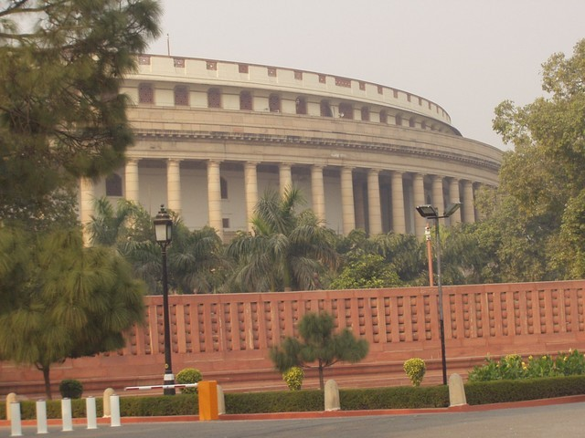
Can You Recognize these Pictures ?
If Yes, How do you Recognize it?
Image Source: Internet

Slide 5
Origin of Machine Learning?
…..Lies in very early efforts of understanding Intelligence.
What is Intelligence?
It can be defined as the ability to comprehend; to understand and profit from experience.
Capability to acquire and Apply Knowledge.
Image Source: Internet

Slide 6
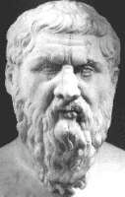
Learning?
2300 Years ago….
Plato (427-347 BC )
The concept of Abstract Ideas are known to us a priori, through a Mystic connection with world.
He concluded that ability to think is found in a priori knowledge of the concepts.
Image Source: Internet

Slide 7
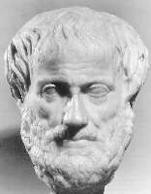
Learning?
Plato’s
Pupil…
Aristotle (384-322 BC)
Criticized his Teacher’s Theory
as it is not taking into account the important aspect
--- An ability to Learn or Adapt to changing world.
Image Source: Internet

Slide 8
Descriptors/ Feature Vectors
Image Source: Internet

Slide 9
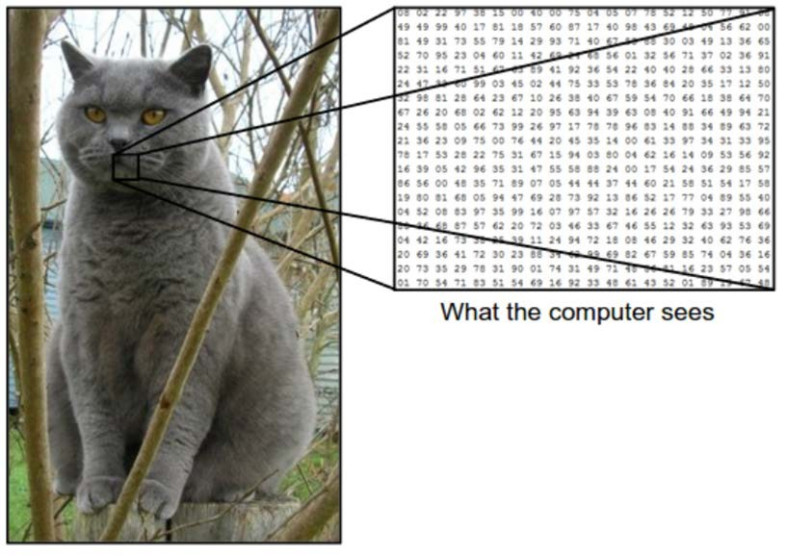
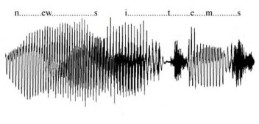
Image Source: Internet

Slide 10
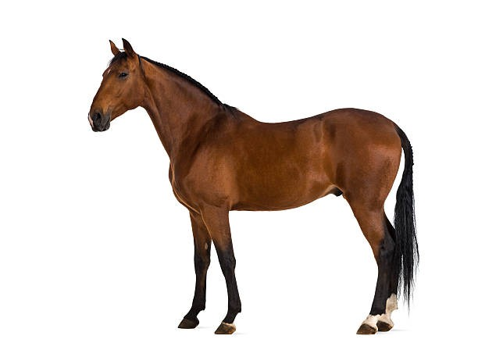
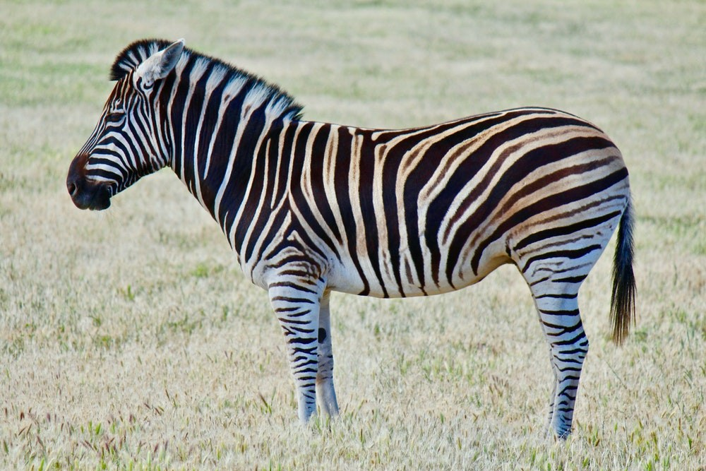
Descriptors/ Feature Vectors
Image Source: Internet

Slide 11
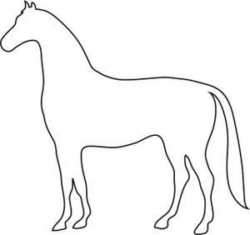
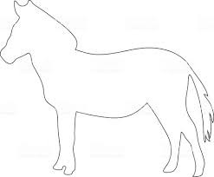
Descriptors/ Feature Vectors
Image Source: Internet

Slide 12
Descriptors/ Feature Vectors
Image Source: Internet

Slide 13
Machine Learning vs
Deep Learning
Image Source: Internet

Slide 14
Discriminative vs. Generative Model
Image Source: Internet

Slide 15



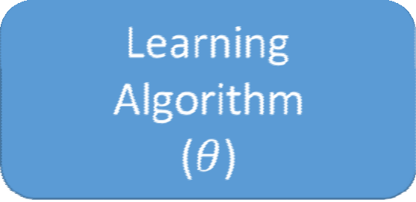





Discriminative Model
Cat
Error Backprop
Loss
Dog
P (X)
Predicted P (Y | X)
Cat Cat
Cat Dog
Dog Cat
Dog
Cat
Cat
Dog
Image Source: Internet

Slide 16
Generative Model
“What I can not create, I do not understand.”
- Richard Feynman
Collect a large amount of data in some domain
Train a model to generate data like it.

Slide 17
Challenges

Slide 18
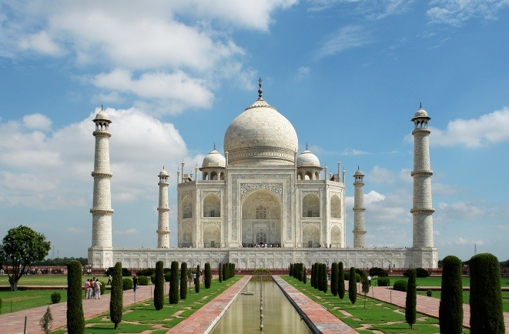


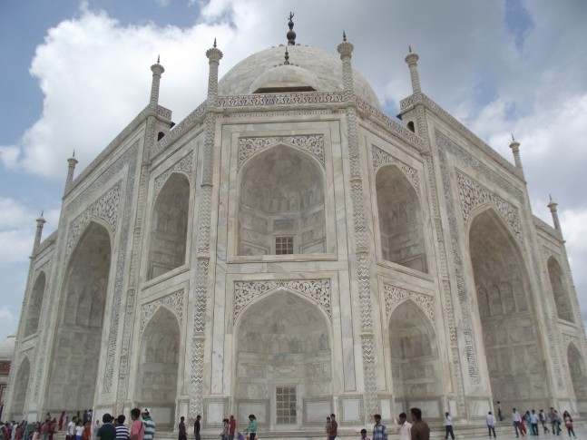
Viewing Angle
Image Source: Internet

Slide 19

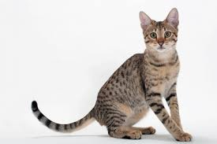


Pose
Image Source: Internet

Slide 20
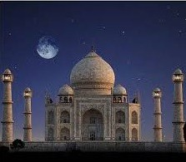

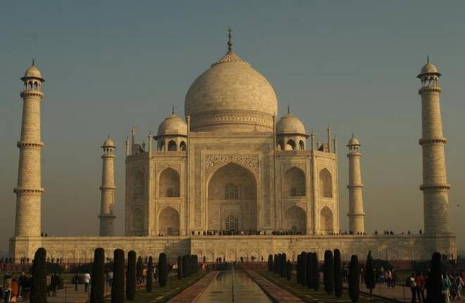


Illumination
Image Source: Internet

Slide 21


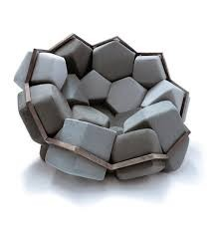



Intraclass Variation
Image Source: Internet

Slide 22



Distortion and Occlusion
Image Source: Internet

Slide 23
Power of Deep Learning

Slide 24
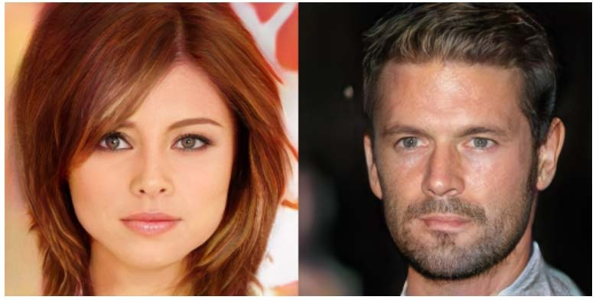
High Resolution Image Synthesis*
* Karras, Tero, Timo Aila, Samuli Laine, and Jaakko Lehtinen. "Progressive growing of gans for improved quality, stability, and variation." ICLR, 2018.

Slide 25
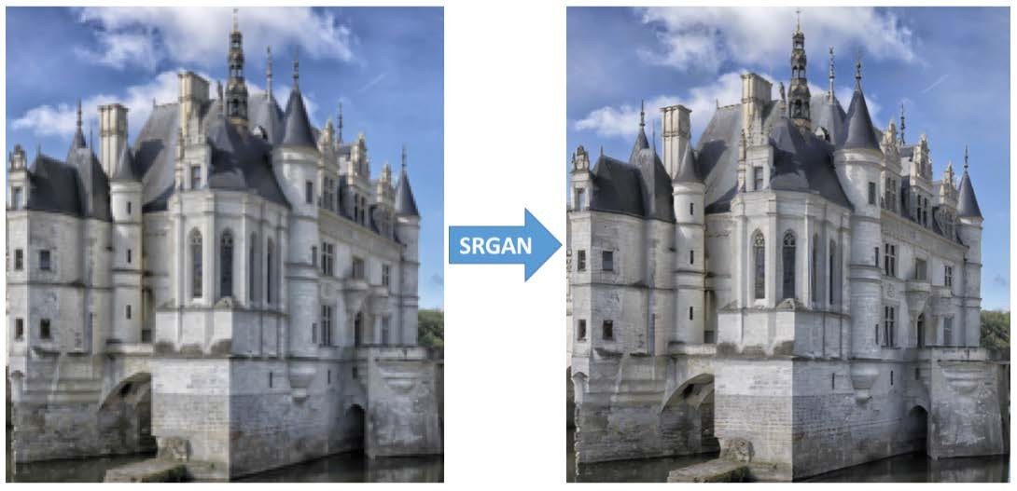
Image Super resolution*
* Ledig et al.. "Photo-Realistic Single Image Super-Resolution Using a Generative Adversarial Network" CVPR 2016

Slide 26
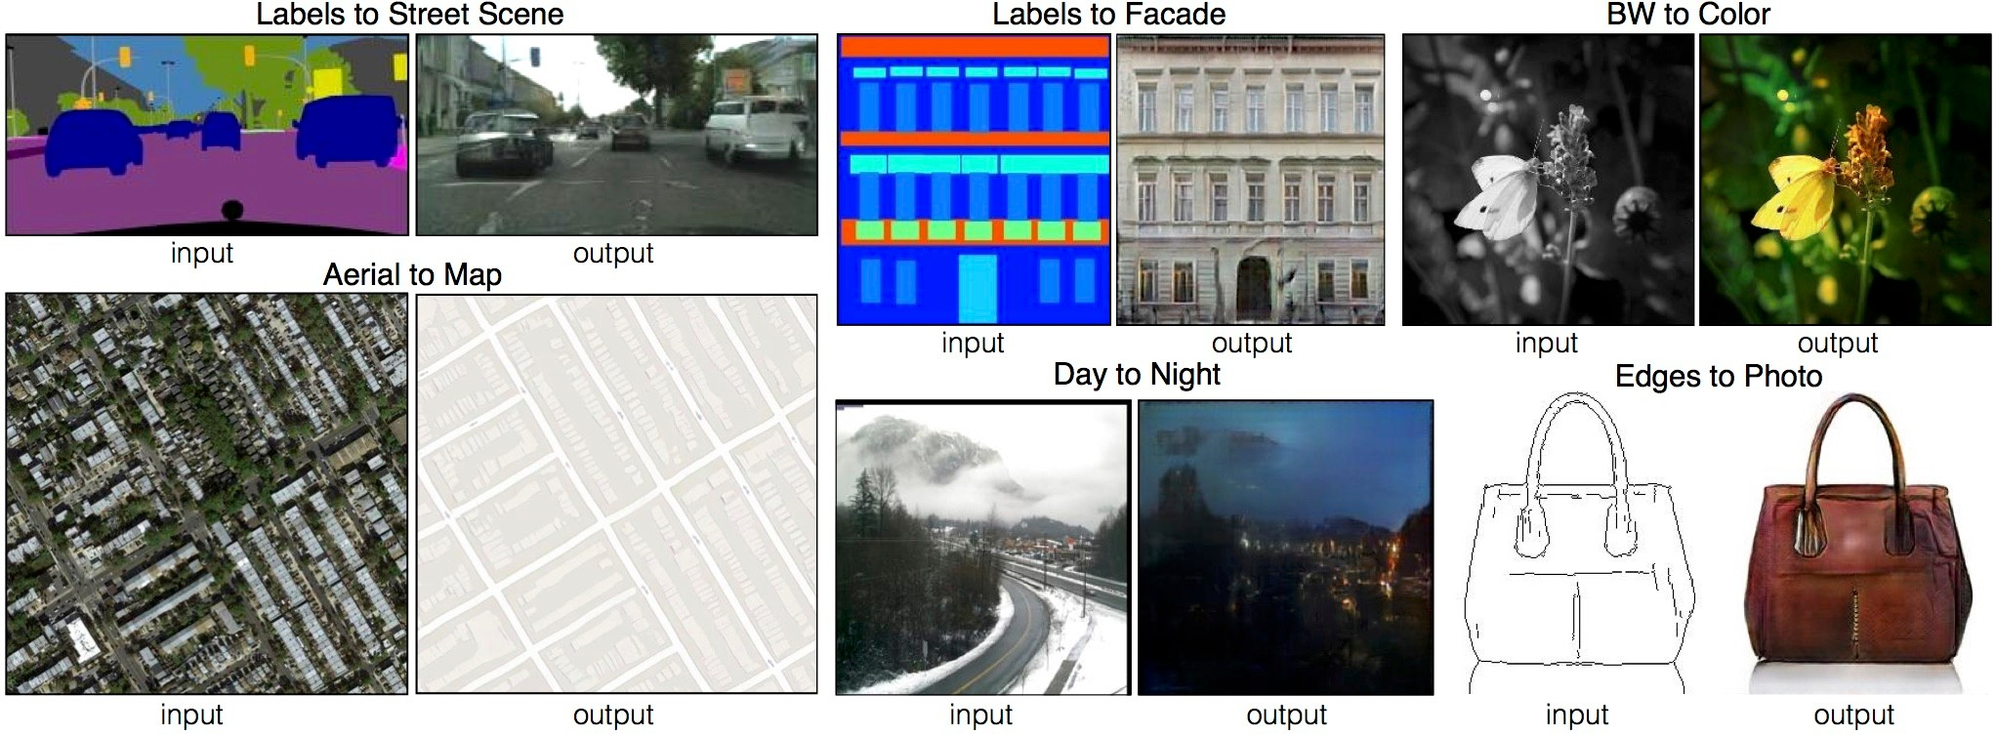
Image to Image Translation*
* Isola, Phillip, Jun-Yan Zhu, Tinghui Zhou, and Alexei A. Efros. "Image-to-image translation with conditional adversarial networks." CVPR, 2017

Slide 27
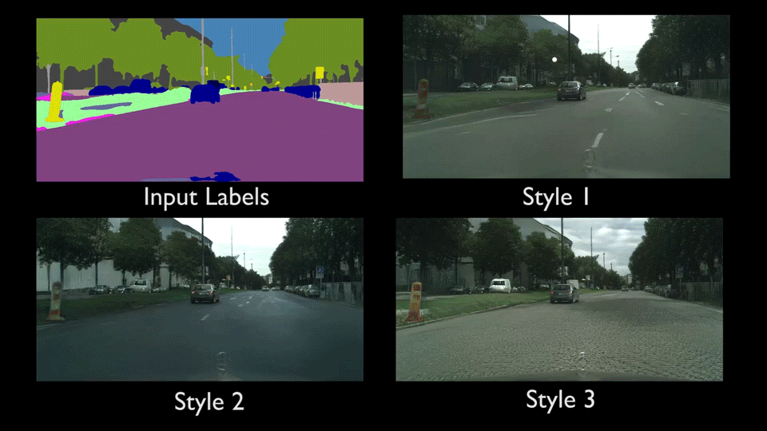
Video to Video Translation*
*Wang, Ting-Chun, Ming-Yu Liu, Jun-Yan Zhu, Guilin Liu, Andrew Tao, Jan Kautz, and Bryan Catanzaro. "Video-to-video synthesis." NeurIPS, 2018

Slide 28
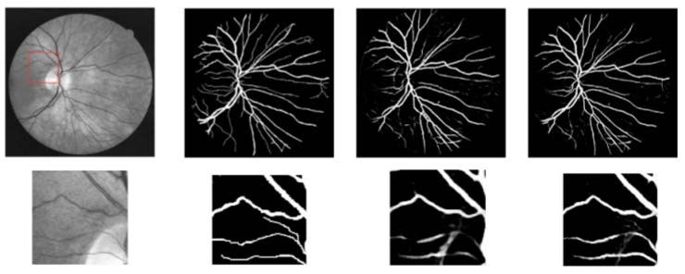
Medical Image Processing

Slide 29
Concepts Covered: Descriptors/ Features
Visual Signals
Boundary Features
Region Features
Audio Signals

Slide 30
Region Descriptors

Slide 31
Region Descriptors
Intensity:
Intensity is quantized by a 8 bit binary number.
Have an intensity at any pixel varying from 0 to 255.
The minimum intensity level or very dark pixel is having an intensity value 0
A white pixel or having an intensity which is maximum the intensity values 255.
Texture:
Two intensity values co-occur within the given image. So, when I say co-occur that is two intensity values i and j, the pixels having intensity values i and j also has to follow certain geometric or locational constant.
Colour:

Slide 32
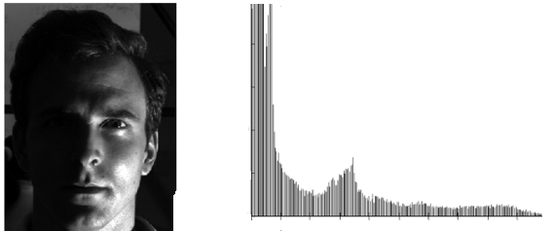
Intensity Descriptor
Image Source: Internet

Slide 33
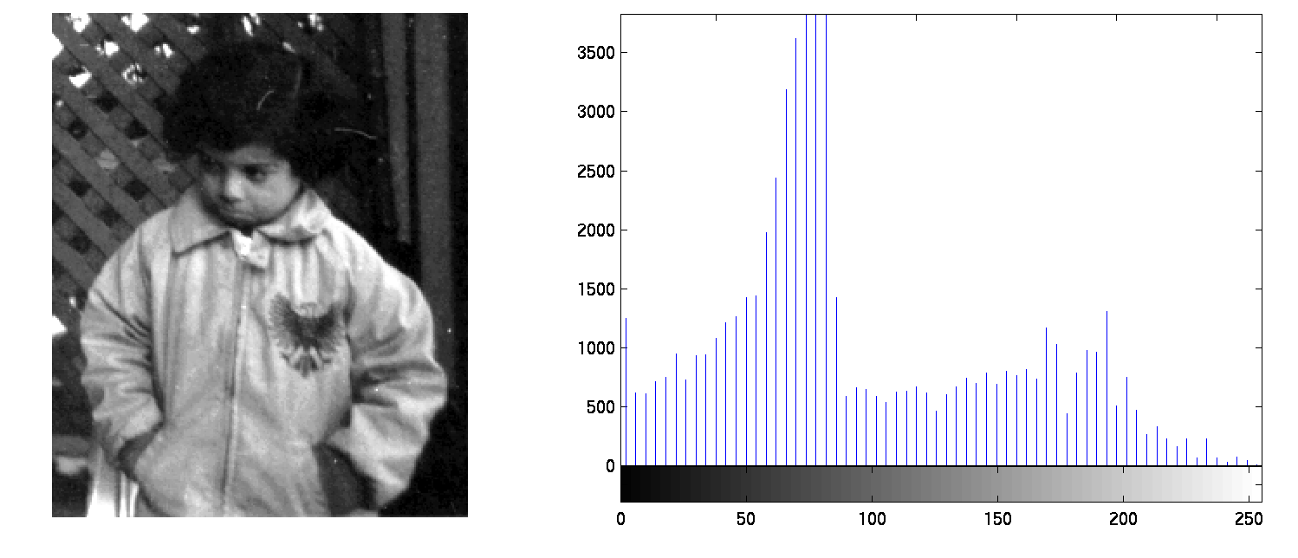
Intensity Descriptor
Image Source: Internet

Slide 34
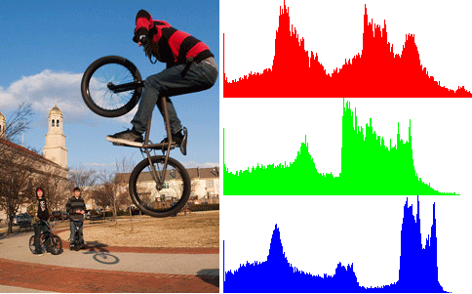
Colour Feature
Image Source:https://billmill.org/the_histogram.html

Slide 35
Texture Descriptors

Slide 36

Pixel Domain/ Co-occurrence Matrix
150 | 100 | 115 | 109 | 112 | 100 | 145 | 140
110 | 112 | 120 | 135 | 125 | 120 | 132 | 133
152 | 99 | 129 | 130 | 122 | 135 | 98 | 100
147 | 138 | 142 | 95 | 108 | 136 | 110 | 125
99 | 127 | 149 | 138 | 138 | 129 | 108 | 129
128 | 125 | 139 | 115 | 120 | 145 | 137 | 131
146 | 159 | 150 | 130 | 147 | 139 | 143 | 127
140 | 120 | 128 | 98 | 100 | 106 | 115 | 119

Slide 37
Topic
Lecture 04: Bayesian Learning

Slide 38
Concepts Covered:
Feature Space Representation
Bayes Rule
Bayes Minimum Error Classifier
Bayes Minimum Risk Classifier

Slide 39

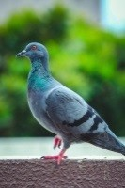









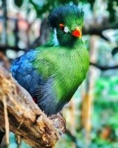














Feature Space Representation
X1
X2
Image Source: Internet

Slide 40

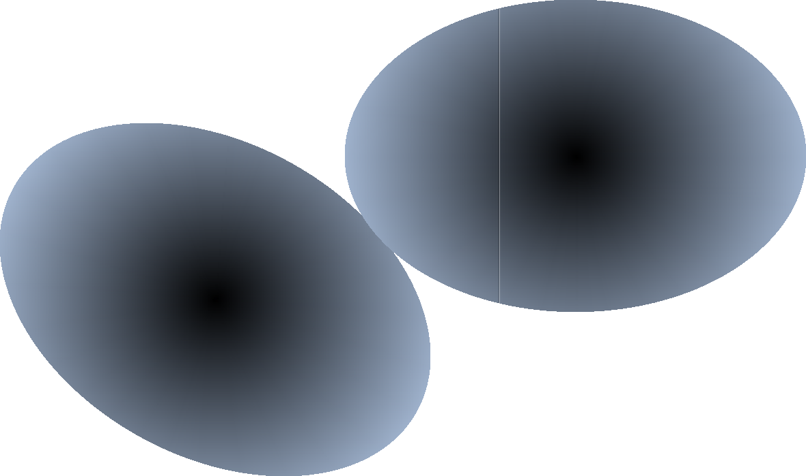
Feature Space Representation
X1
X2

Slide 41
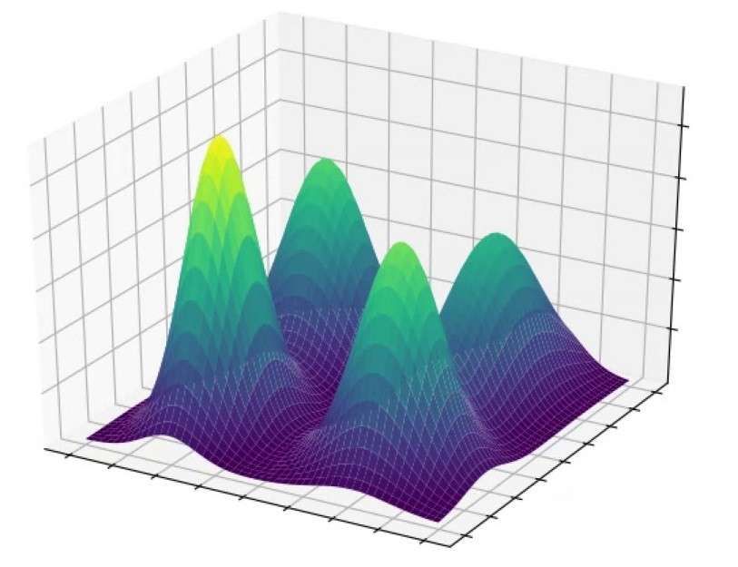
Feature Space Representation
p( X / ω_{i} )
X₁
X ₂
Image Source: Internet

Slide 42
Bayesian Learning
The probability of joint events A and B is:
P (A and B)= P (A|B) P (B)
Where A is my feature vector X and B is our class ωi
Probability:
P (X|ωi) * P (ωi) = P (ωi|X) * P (X)
Class conditional probability:
P (X|cars)
X is the feature vector and cars are my class
Priori probability:
P (birds) And P (cars)

Slide 43
Bayesian Leaning
P (X/Cars)
P (Birds) P (Cars)
P( X|ωi) * P (ωi) = P (ωi | X) * P (X)
P (ωi | X) = P ( X|ωi) * P (ωi)/P (X)
Similarly
P ( X|ωj) * P (ωj) = P (ωj | X) * P (X)
P (ωj | X) = P ( X|ωj) * P (ωj)/ P (X)
P(X) is nothing, but
P (X) = ∑ P (X | ωi) * P (ωi)
∀i
P ( ωi |X) > P ( ωj |X )
if X is belongs to class (ωi)

Slide 44
Bayesian Leaning
P (ωi | X) = P ( X|ωi) * P (ωi)/P (X)
P (ωj | X) = P ( X|ωj) * P (ωj)/ P (X)
Ignore P(X) as does not contribute anything in the discrimination.
So, we can simply compute
P ( ωi |X) = P (X|ωi) * P (ωi)
P ( ωj |X) = P (X|ωj ) * P (ωj )
If
P ( ωi |X) > P ( ωj |X)
then X belongs to the class of ωi

Slide 45
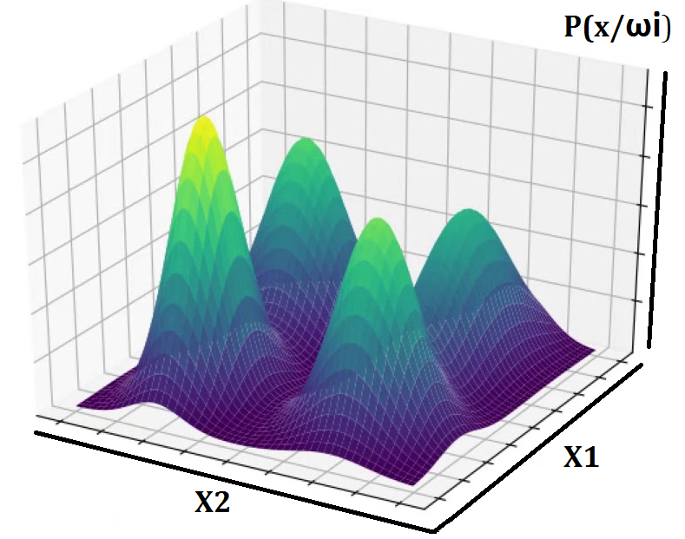
Feature Distribution
P ( ωi |X) = P (X|ωi) * P (ωi)
P (Car|X) = P (X|Car) * P (Car)
P (Bird|X) = P (X|Bird) * P (Bird)

Slide 46
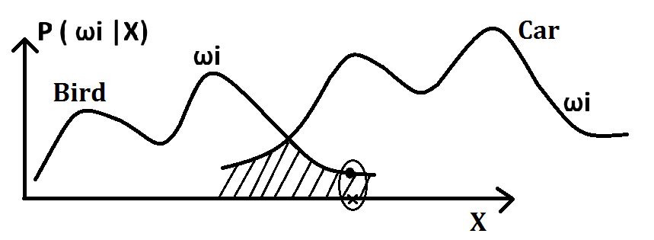
Bayes Minimum Error Classification
P ( ωi |X) > P ( ωj |X)
P ( error |X) = min {P ( ωi |X) , P ( ωj |X)}

Slide 47
Bays Minimum Risk Classifier
ω_{i} ; i = 1, 2,..C.
α_{i} ; i = 1, 2,..K.
X: d dimensional feature Vector
loss function λ which is λ(α_{i} | ωj )
R (α_{i} /X) = ∑ λ(αi | ωj ) * P (ωj | X)
∀j

Slide 48
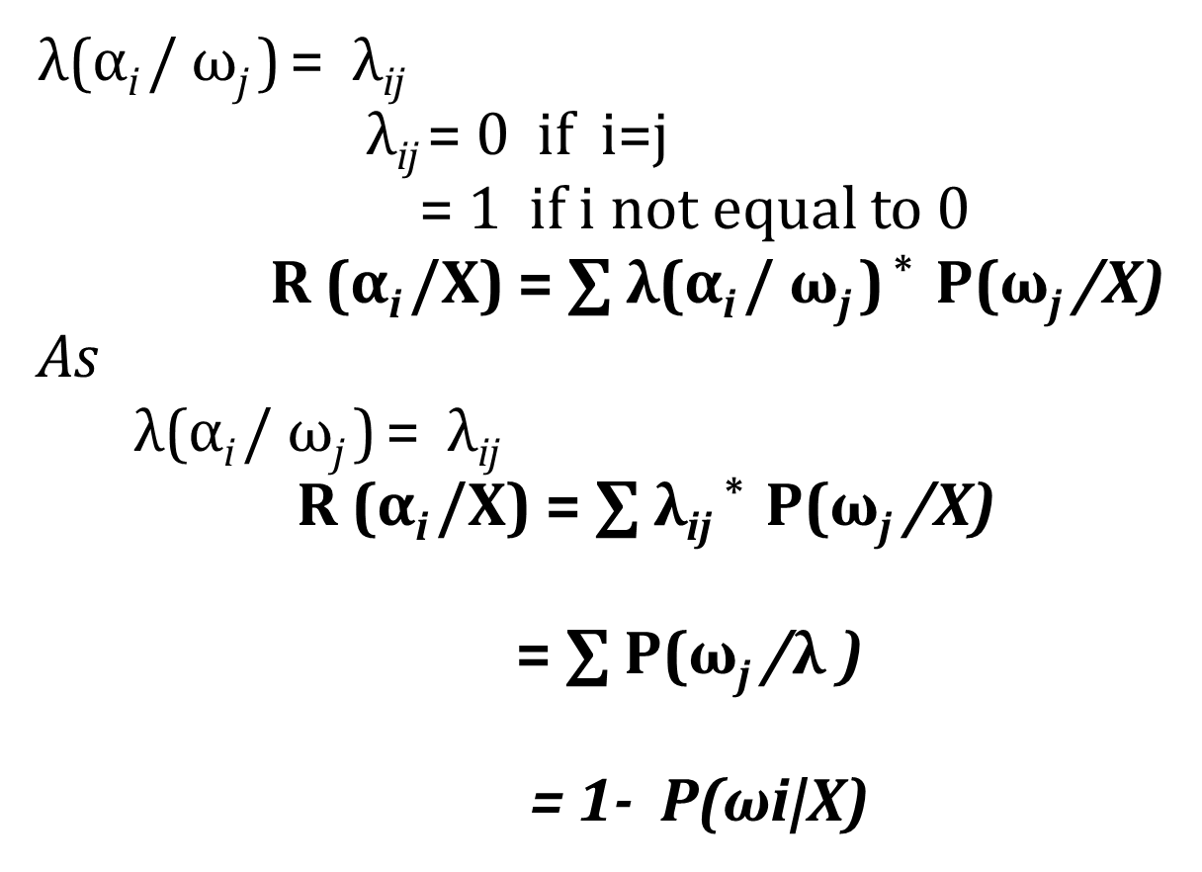
Bayes Minimum Risk Classification

Slide 49
K number of Action
α_{i} : i = 1 ……. k
For two class problem
α1 α2
ω₁ ω₂
Loss Function : λ(α_{i} / ω_{j} ) = λ_{ij}
R (α1 /X) and R (α2 /X)
α_{i}
ω_{j}
X
R (α_{i} /X) = ∑ λ(α_{i} / ω_{j} ) * P(ω_{j} /X)
∀j

Slide 51
END

